Slide 1
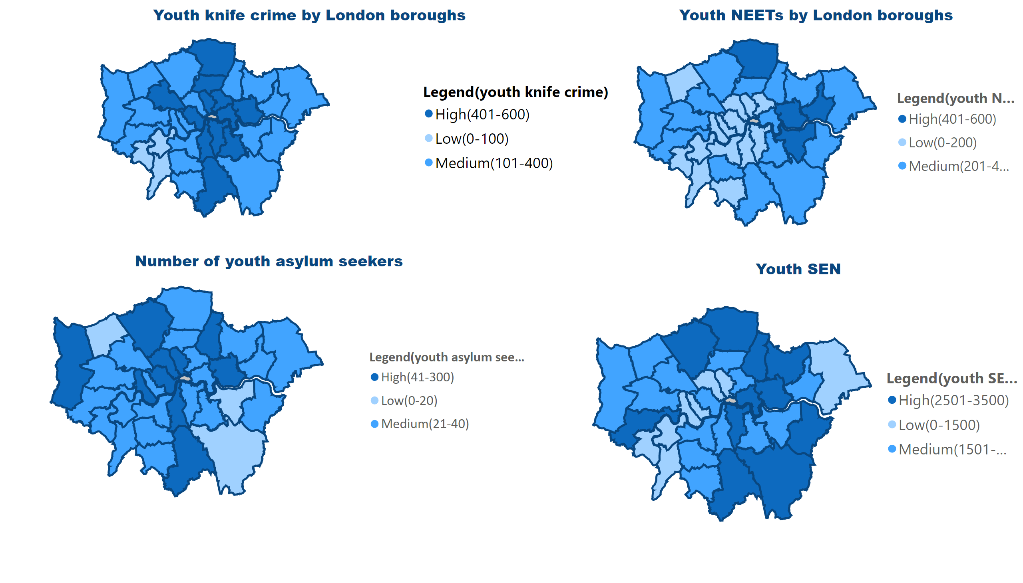
Youth engagement 1
Notes:
Youth knife crime by London boroughs
No alt text provided
Number of youth asylum seekers
No alt text provided
Youth SEN
No alt text provided
Youth NEETs by London boroughs
No alt text provided

Slide 2
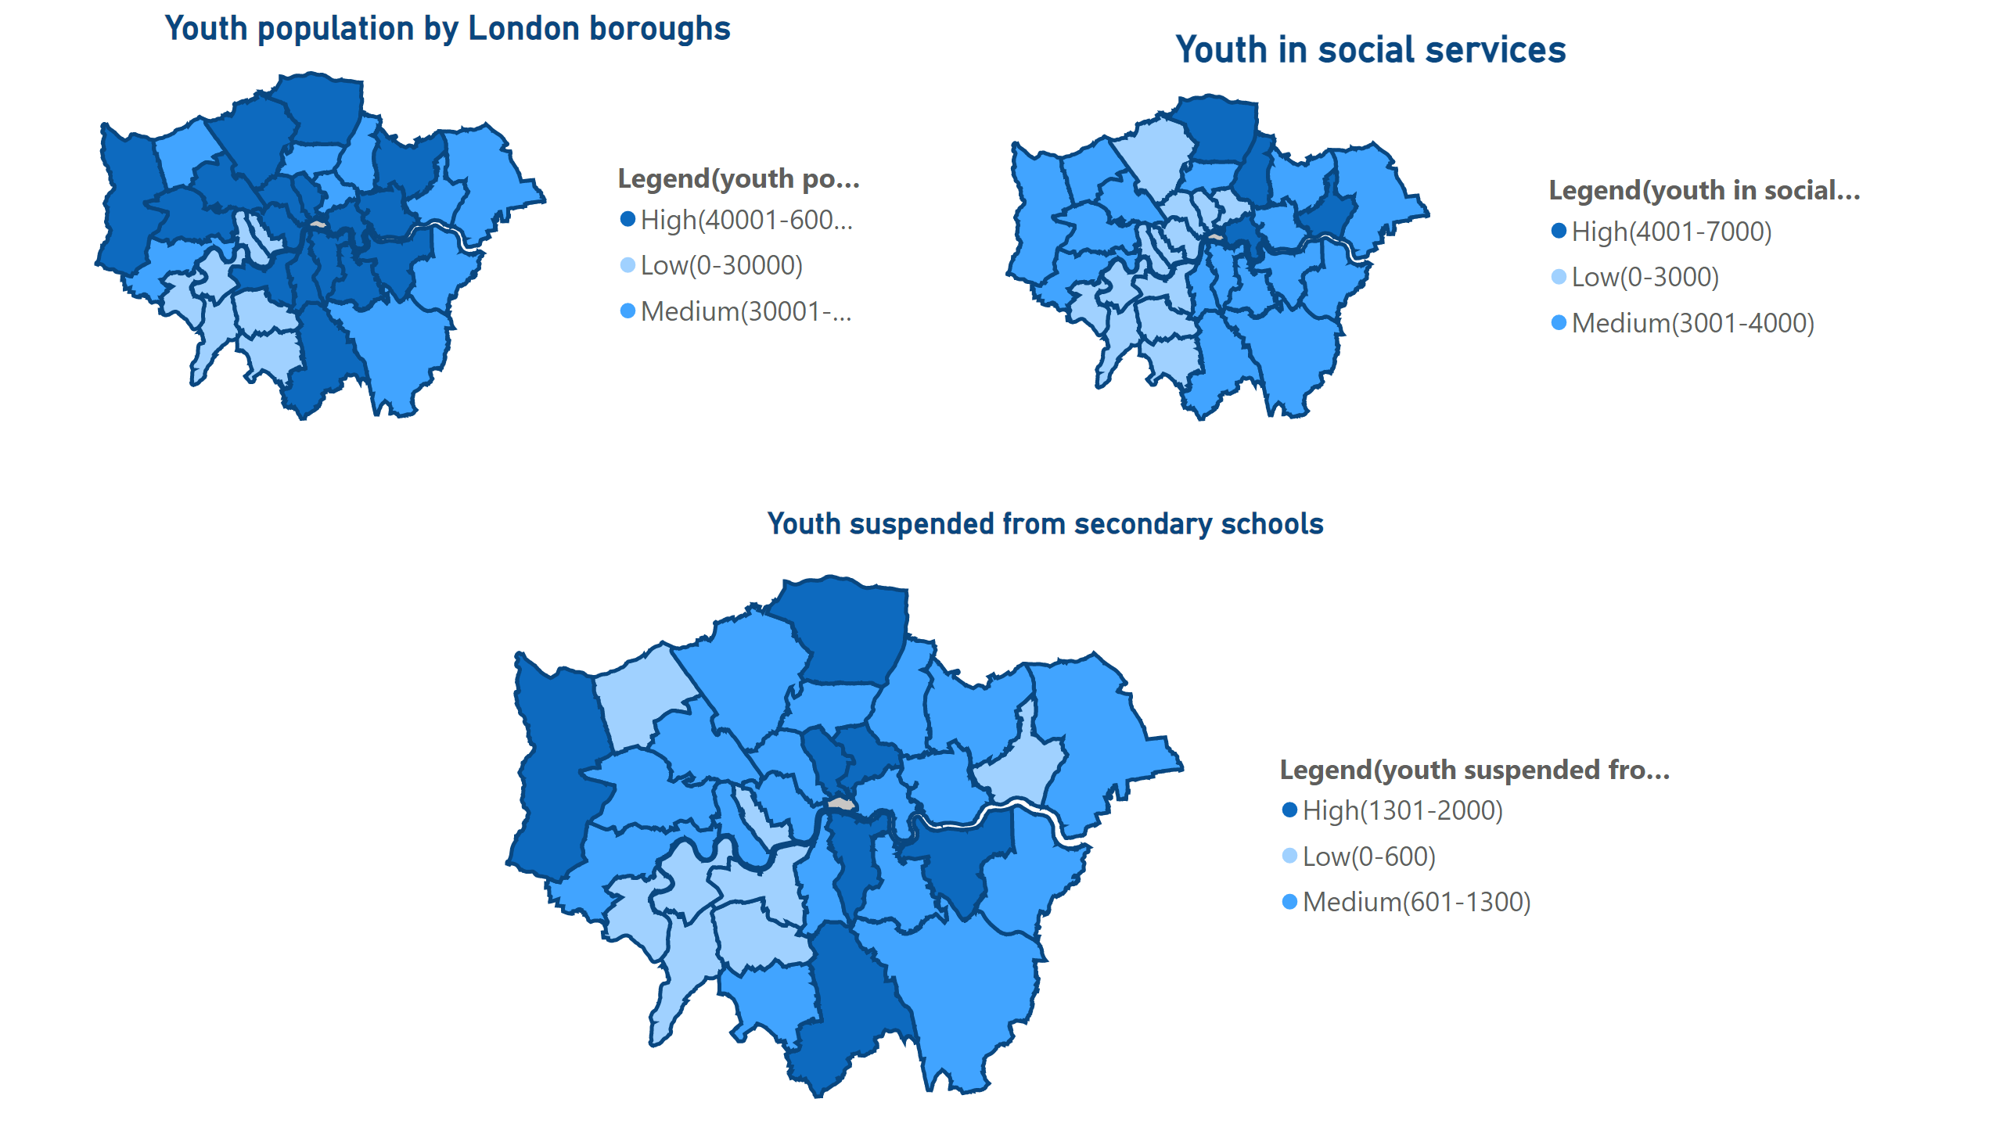
youth engagement 2
Notes:
shapeMap
No alt text provided
Youth population by London boroughs
No alt text provided
Youth in social services
No alt text provided
Youth suspended from secondary schools
No alt text provided

